Slide 1

Optimization Algorithms
Exponentially weighted averages
deeplearning.ai

Slide 2
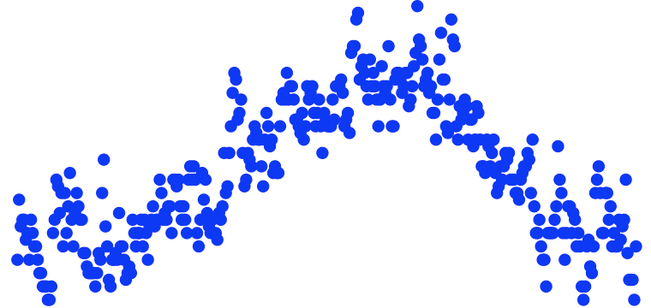
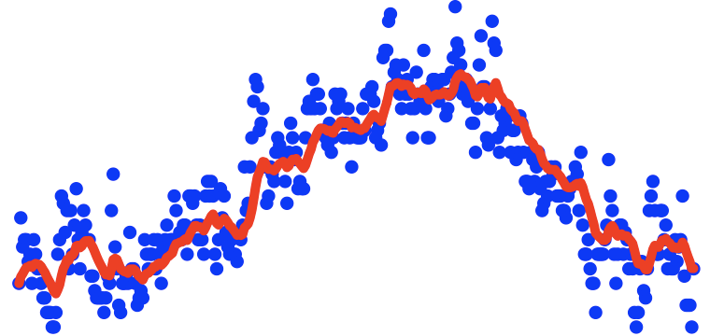




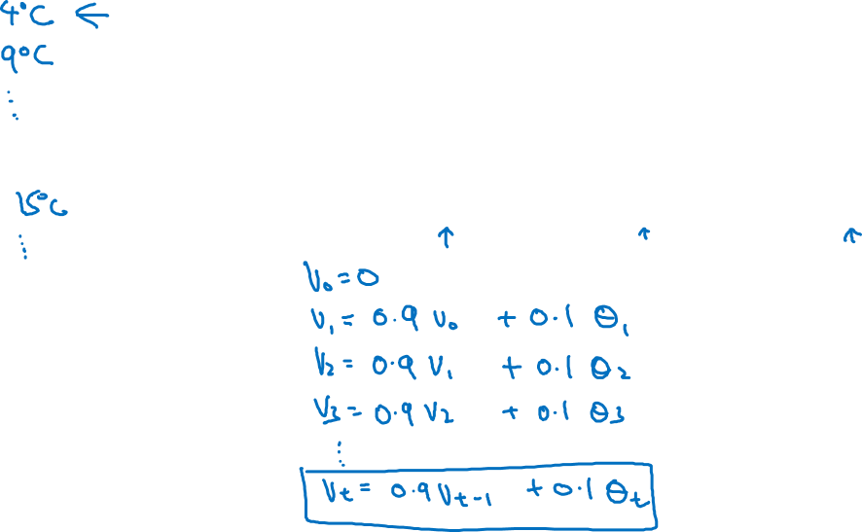

Temperature in London
$$θ_{1}=40°F$$
$$θ_{2}=49°F$$
$$θ_{3}=45°F$$
temperature
.
.
.
$$θ_{180}=60°F$$
$$θ_{181}=56°F$$
days
.
.
.

Slide 3
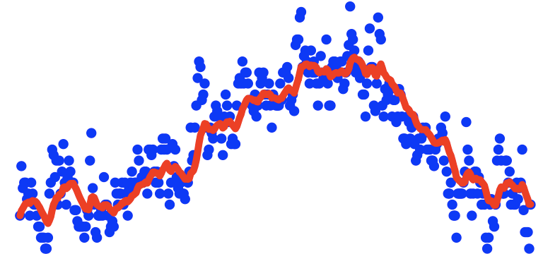
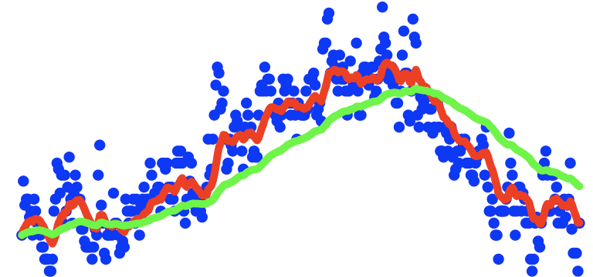
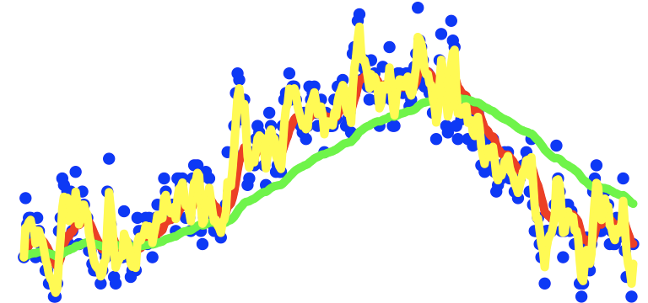
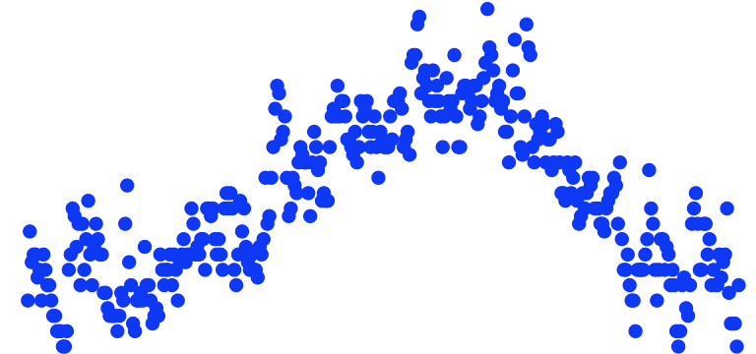
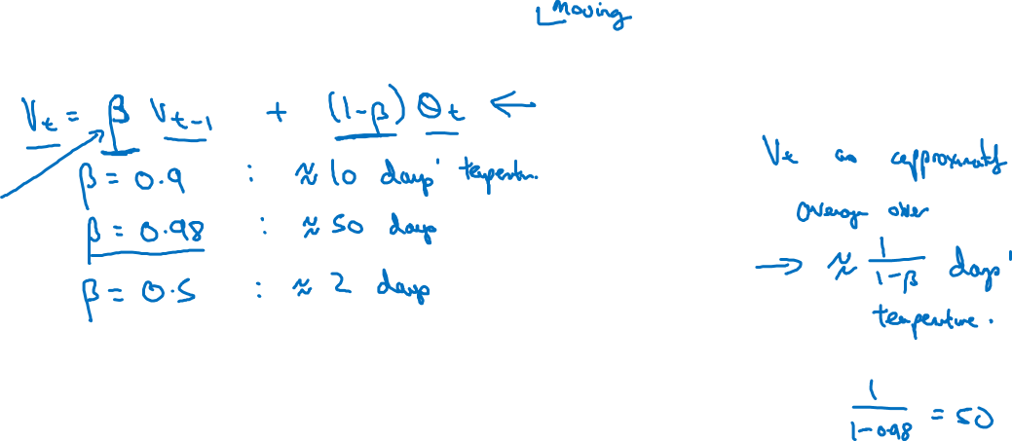
Exponentially weighted averages
temperature
days

